Slide 1
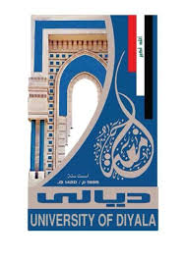
DIYALA UNIVERSITY COLLEGE OF ENGINEERING DEPARTMENT OF COMMUNICATION ENGINEERING
Electronic Circuits II
Second Year. Lecture 9
lecturer
Wisam Hayder
2021

Slide 2
Four Layer Devices
What is a Thyristor?
A thyristor is a four layer solid-state semiconductor device with P and N type material.
Whenever a gate receives a triggering current then it starts’ conducting until the
voltage across the thyistor device is under forward bias.
So it acts as a bistable switch under this condition.
To control the large amount of current of the two leads we have to
design a three lead thyristor by combining the small amount of current to that current.
This process is known as control lead.
If the potential difference between the two leads is under breakdown voltage,
then a two lead thyristor is used to switch on the device.
Notes:
aaa

Slide 3
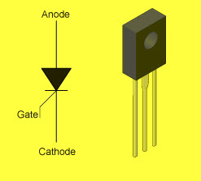
Four Layer Devices
Thyristor
Notes:
aaa

Slide 4
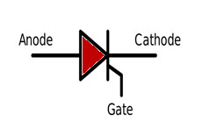
Four Layer Devices
Thyristor Circuit Symbol
Thyistor circuit symbol is as given below. It has three terminals Anode, cathode and gate.
TRIAC Symbol
Notes:
aaa

Slide 5
Four Layer Devices
There are three states in a thyristor
Reverse blocking mode– In this mode of operation, the diode will block the voltage which is applied.
Forward blocking mode– In this mode, the voltage applied in a direction makes a diode to conduct. But conduction will not happen here because the thyristor has not triggered.
Forward conducting mode– The thyristor has triggered and current will flow through the device until the forward current reaches below the threshold value which is known as “Holding current”.
Notes:
aaa

Slide 6
Four Layer Devices
If a V_{G} (Positive potential) is applied to the gate terminal, then a breakdown occurs at the junction J2 which will be of low value V_{AK}. The thyristor can switch to ON state, by selecting a proper value V_{G}. Under avalanche breakdown condition, the thyristor will conduct continuously without taking consideration of gate voltage, until and unless,

Slide 7
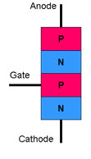
Four Layer Devices
The potential V_{AK} is removed or Holding current is greater than the current flowing through the device Here V_{G}– Voltage pulse which is the output voltage of the UJT relaxation oscillator.
Thyristor Layer Diagram
Notes:
aaa

Slide 8
Four Layer Devices
Thyristor switching circuits
DC Thyristor Circuit
AC Thyristor circuit
DC Thyristor Circuit
When connected to the DC supply, to control the larger DC loads and current we use thyristor. The main advantage of thyristor in a DC circuit as a switch gives a high gain in current. A small gate current can control large amounts of anode current, so the thyristor is known as a current operated device.
Notes:
aaa

Slide 9
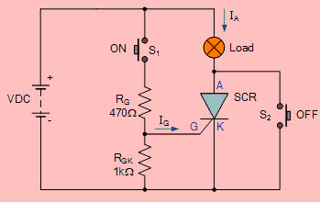
Four Layer Devices
DC Thyristor Circuit
Notes:
aaa

Slide 10
Four Layer Devices
AC Thyristor Circuit
When connected to the AC supply, thyristor acts differently because it is not same as DC connected circuit. During one half of a cycle, thyristor used as an AC circuit causing it to turn off automatically due to its reverse biased condition.
Notes:
aaa

Slide 11
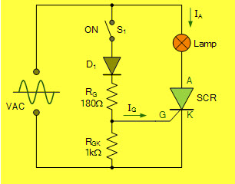
Four Layer Devices
Thyristor AC Circuit
Notes:
aaa

Slide 12
Four Layer Devices
Types of Thyristors
Based on turn on and turn off capabilities the thyristors are classified into the following types:
Silicon controlled thyristor or SCRs
Gate turn off thyristors or GTOs
Emitter turn off thyristors or ETOs
Reverse conducting thyristors or RCTs
Bidirectional Triode Thyristors or TRIACs
MOS turn off thyristors or MTOs
Bidirectional phase controlled thyristors or BCTs
Fast switching thyristors or SCRs
Light activated silicon controlled rectifiers or LASCRs
FET controlled thyristors or FET-CTHs
Integrated gate commutated Thyristors or IGCTs
For better understanding of this concept,here we are explaining some of the types of thyristors.
Notes:
aaa

Slide 13
Four Layer Devices
Silicon Controlled Rectifier (SCR)
A silicon controlled rectifier is also known as thyristor rectifier. It is a four layered current controlling solid state device. SCRs can conduct current in only one direction (unidirectional devices). SCRs can be triggered normally by the current which is applied to the gate terminal. To know more about SCR. Please follow the link to know more about: SCR tutorial basics and characteristics
Notes:
aaa

Slide 14
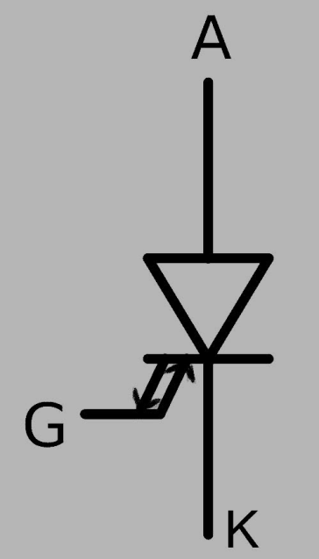
Operational Amplifiers (Op-Amp)
Gate turn off Thyristors (GTOs)
One of the special types of high power semiconductor devices is GTO (gate turn-off thyristor). The gate terminal controls the switches to be turned ON and OFF.
GTO Symbol
Notes:
aaa

Slide 15
Four Layer Devices
If positive pulse applied between the cathode and gate terminals, then the device will be turned ON. Cathode and gate terminals behave as a PN junction and there exists a small voltage relatively between the terminals. It is not reliable as an SCR. To improve the reliability we must maintain a small amount of positive gate current.
If negative voltage pulse applied between the gate and cathode terminals, then the device will turn OFF. To induce the gate cathode voltage some of forward current is stolen, which in turn induced forward current may fall and automatically GTO will transition to the blocking state.
Applications
Variable speed motor drives
High power inverters and traction
Notes:
aaa

Slide 16
Four Layer Devices
GTO Application on Variable Speed Drive
There are two main reasons for adjustable speed drive is process energy conversation and control. And it provides smoother operation. High frequency reverse conducting GTO is available in this application.
Notes:
aaa

Slide 17
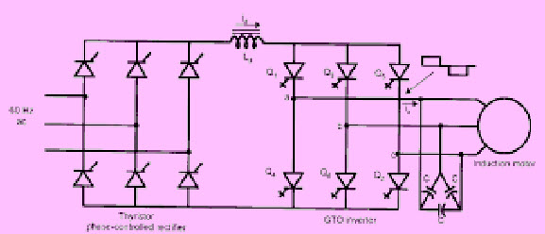
Four Layer Devices
GTO Application

